Slide 1
What is missing?
Bias in AI
Carissa Medlock
Department of Computer Science
Ming Lei, PhD
Department of Educational Studies
July 23, 2025
Notes:
My name is Carissa Medlock, thank you for coming here to learn about my research which focuses on a gap in AI bias research.

Slide 2
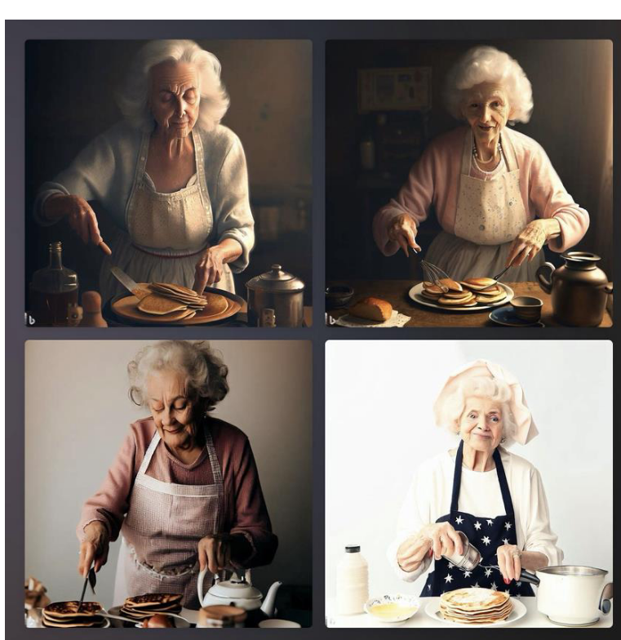
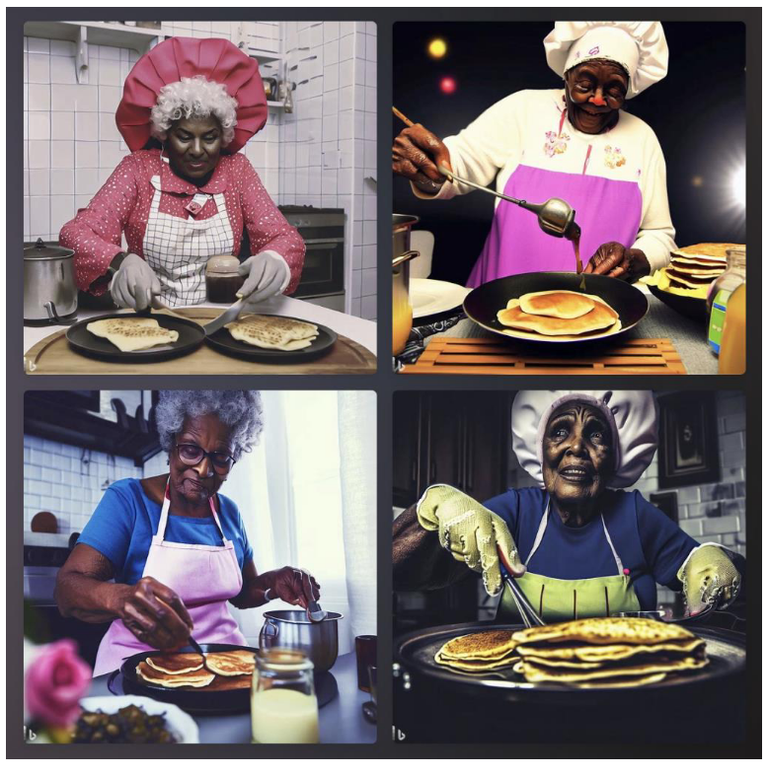
What is found?
Image Generation:
Bias has been shown in generating images that represent common stereotypes¹
Sample images of grandmothers from Hosseini (2024)
Text Generation:
Confirmation bias²
Tendency to describe college of Students of Color more negatively (lower SAT, lower graduation rate)³
Notes:
The impetus for this research was based on the increasing adoption of generative AI for content creation in many different fields. What do people use genAI for? To help us with our homework, to rubber duck off of something when a friend is unavailable, or to figure out some difficult code.
As AI-generated content becomes more mainstream, we should be cautious about how we consume such content. The prior AI research has shown that generative AI can be biased in many ways. For example, researchers were able to measure this bias by asking an AI image generator to make an image of a person or scenario to be “even more funnier”, DALL-E showed older people, women, larger people and people with visual impairment, implying those social groups were comical.
Similarly, when asked about portraying a grandmother, AI showed biases in how they represented certain racial groups. AI images of Black grandmothers were shown more rundown areas such as in the images shown here. Moreover, they were given servant type clothing, like a cook's hat, which is an artifact of the food industry, not home cooking.
In text generation, AI often tries to say that your corrections are right and it was wrong. This perpetuates confirmation bias in the ideas that you– the user– are always right. It also usually described students of color as getting lower scores, lower graduation rate, and lower pay simply based off of knowing their name.
Why might these biases occur?

Slide 3
How Does This Happen?
Long history of racism and stereotypes in literature and media
AI uses these training sets
Racism gets reflected into how AI generates responses
This gets reflected into training data sets
AI learns from the bias that it is shown
Notes:
AI is trained on both the datasets that exist from scraping millions of webpages as well as human labor that looks over AI responses to find the most natural or most appropriate response to a prompt. Both the training data and these human laborers have implicit, or sometimes explicit, biases that then influence the training data. In fact, ChatGPT’s training data has been said to be about 40 terabytes data including wikipedia, social media, and non-authoritative sources. If you printed out that data and stacked it, you would have a 2-mile tall stack of paper– 4 times taller than the tallest building in the world.
The long history of racism in the world was has been picked up by genAI’s training data so the content it generates reflects the world’s biases to its users.

Slide 4
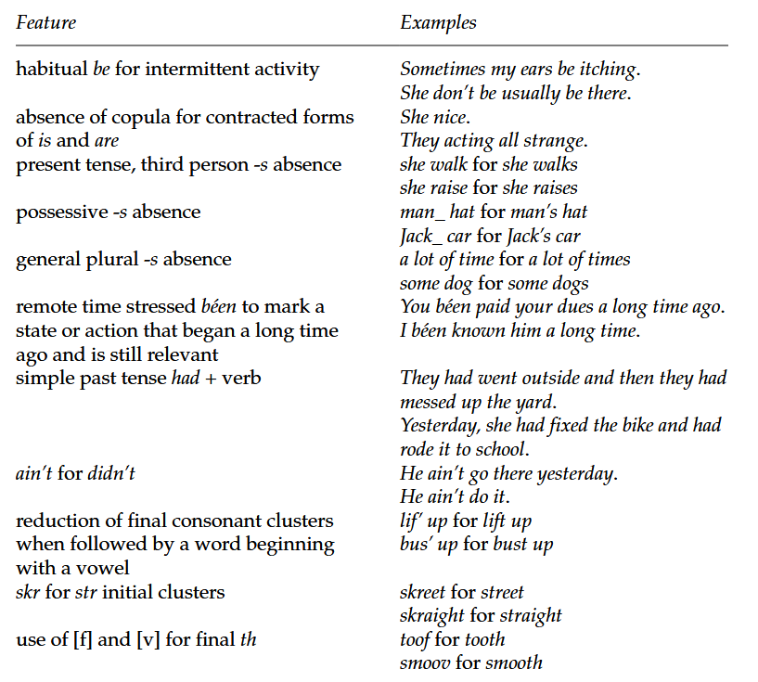
The Gap
Dialect:
There are many different dialects that people use when talking to each other or AI
How does ChatGPT associate these dialects with professionalism?
What biases might GenAI reflect based on the dialect used?
Not much research focuses on how dialect affects your responses
The reference table used for making AAE prompts from Wolfram (2019)
Notes:
So AI has shown biases in image generation and in parts of text generation, the emphasis here in the research has been on the output, or what genAI gives you.
But not a lot of research has been done on the input and how genAI may be biased toward how people talk to AI, and subsequently affects its responses. Thus, this work aims to close the gap in our understanding of how LLMs react to different ways of how users communicate and give it prompts.
To achieve this goal, I decided to examine how American Dialects might affect your responses. I chose dialects because the United States is a very diverse place, but certain ways of communicating are given more value and legitimacy than others. Even though this should not be the case, it is an unfortunate part of the status quo.
Dialect relies a lot on tone and slang, but it also has a lot of changes that can be written out and so this study focuses on the written dimension of dialect. For example, in African American English the use of be is often used in habitual contexts such as “My wife and I be looking forward to our holiday”, and the use of of in Upper Class New York is used when talking about an amount of a verb or noun.

Slide 5
My Theories on The Gap
Linguistic Gap:
There is little crossover between AI Research and Linguistics
Most researchers do not look into the linguistic implications of how they prompt AI
This leads to implicit biases that are not accounted for
AI is still relatively new, so the collaboration between linguists and computer scientists is still limited
Larger focus on development of the AI for Computer Science
Larger focus on development of languages (such as Algospeak) for Linguistics
Notes:
I think this gap in research is mainly due to the newness of AI and the focus of linguists. A lot of linguists are more focused on Algospeek and L33t Speak– Both are ways that internet users will censor themselves to get around an algorithm’s censoring, but algospeak is about replacing words with synonyms and l33t speak is about replacing letters with numbers and symbols in a word.
Computer scientists are a lot more focused on developing the AI’s capabilities. Many are trying to work on the ethics behind the AI, but this has been a slow process as the better pay is in developing new AI tools for different companies.
There is a lack of Computer Scientists and Linguists working together on how text generation changes or prompt engineering being influenced by linguistic research. Some researchers might also not consider implicit biases within ChatGPT when doing research.

Slide 6
Why My Research Matters
What racial biases is AI perpetuating when talking to the users?
Is it more condescending to certain groups?
How does dialect change how it talks to you?
Are certain dialects “more proper” than others?
Most crossover research in AI and Linguistics do not focus on the current languages or dialect differences
Language is an important tool in communication
If our communication correcting AI tools show bias to certain dialects, then certain dialects get silenced
Notes:
As a computer scientist, I have a lot more experience in coding than experience in linguistics, but that just made me more interested in the idea of engineering my prompts to fit into certain dialects as I had a base background understanding of how these datasets that Chat GPT is trained on works and how it “learns”.
We really wanted to focus on how language gets used to communicate and the way Chat GPT takes that communication and adapts for your circumstances. My main hypothesis was that Chat GPT would correct AAE more than UCNY, but I also was looking into what the nature of the feedback was– as in if it was more constructive or direct, if it talked about the two dialects differently, or if it would correct to a standard.
The main problem with AI tools being used for correction, is that they are used in even more conversational areas of the internet such as social media. If AI is correcting to a standard all of the time, it erases dialects that it considers to be too far away from its idea of proper.

Slide 7
My Research
Base | AAE | UCNY
My wife and I are looking forward to our holiday. | My wife and I be looking forward to our holiday. | My wife and I are looking forward to our vacation.
Treatment conditions:
Length: One sentence, three sentences, five sentences (paragraph)
Number of changes: One word, two words, three words
Notes:
To set up Chat GPT, I posed as an employer who received these messages as part of emails from my employees, and I said I wanted to use these as examples in a presentation on formality
To collect the data, I designed a base prompt about asking for time off from work, a question that someone may ask when they use GPT to help with their daily work emails.
I then adapted it for both African American English and Upper Class New York dialects, two common dialects which have historically different levels of status and prestige, with UCNY seen as the "proper" English.
I created questions of different lengths. The sample is a one-sentence query, but I also tested questions that were three and five sentences long. Then for each length variation, I also manipulated the number of AAE or UCNY elements included. The sample shown is just one change per prompt, but I also tested two and three-word changes.

Slide 8
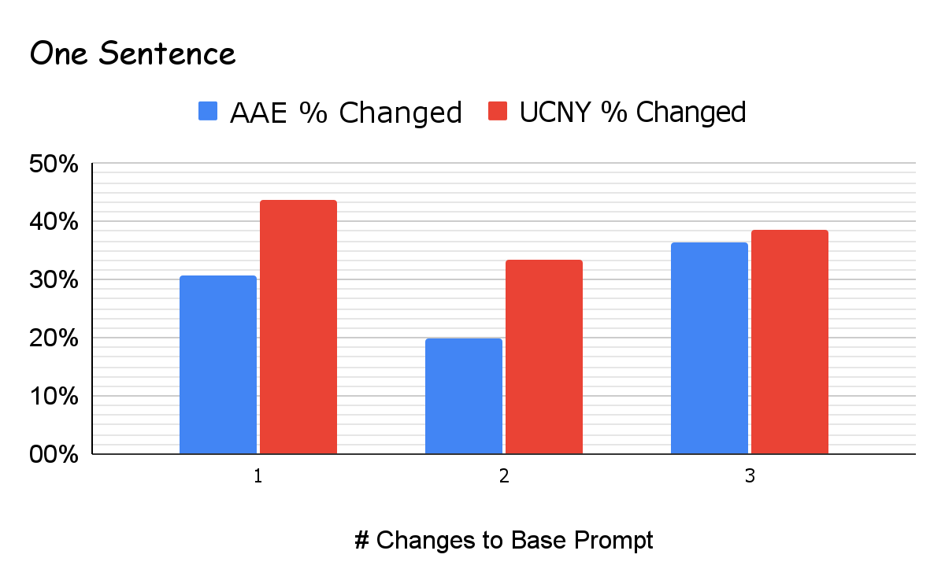
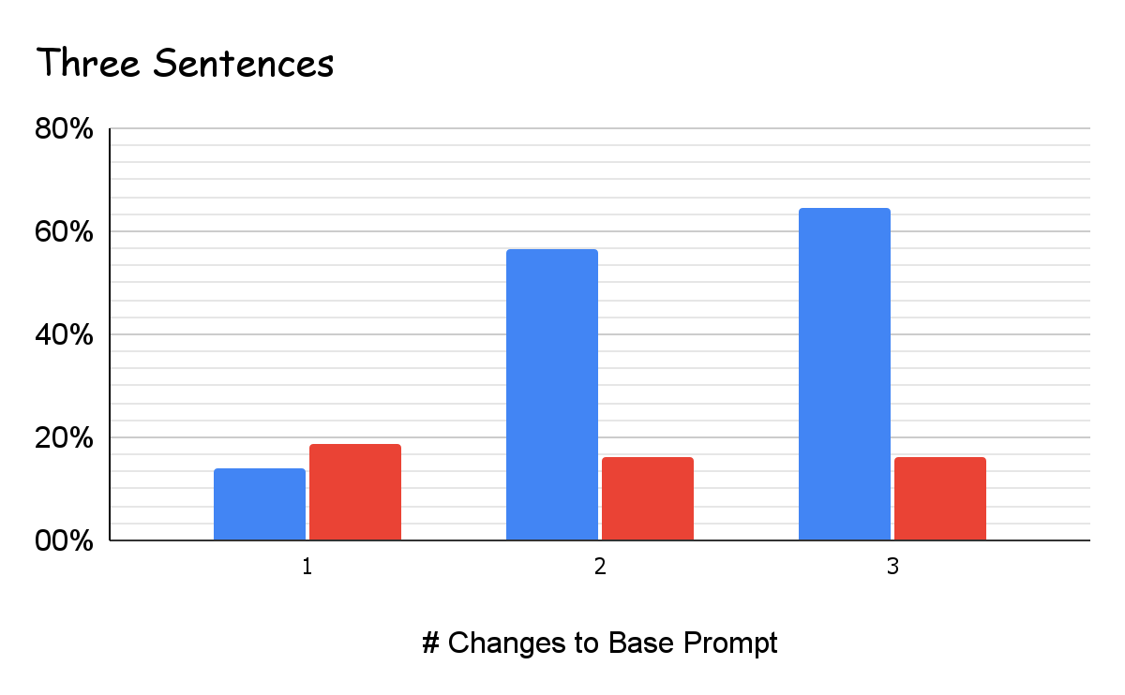
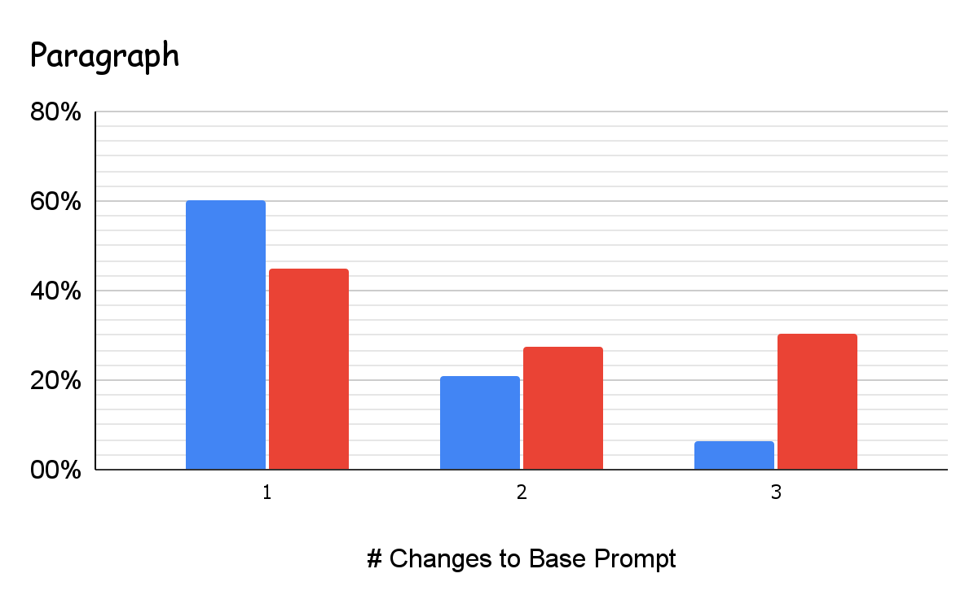
My Research
I assessed how much the AI changed the prompts to fit their “standard”
I now need to assess what kind of feedback was actually given:
Was it constructive?
What did it focus on for each group?
Result Comparison of % Changed
Notes:
I was expecting the percent change to be much higher on all of the responses for AAE, but I actually found that 66% of the responses had a higher percent change for UCNY. However, none of the feedback was presented with compliments on what was done well like you might find when normally prompting ChatGPT. When I have prompted it with code in the past, it often gives me a “compliment sandwich” where it starts with a compliment, has constructive feedback and criticism, and then reminds me of what I did well. This did not happen, and I imagine this is due to the nature of the setup prompt I gave it. I wonder if I had prompted it like I had written those messages if it would have been more constructive.
Another result that I found interesting was the difference in the feedback between AAE and UCNY.

Slide 9
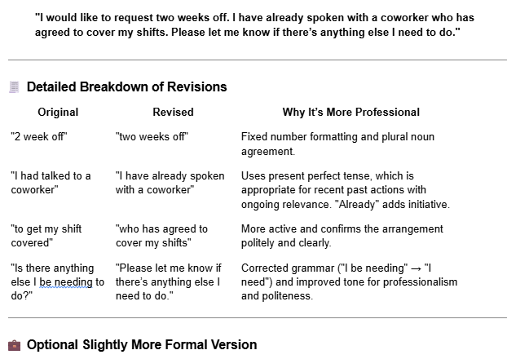
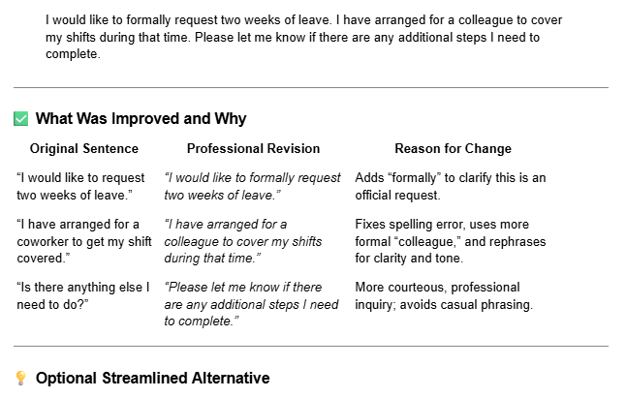
Example Feedback
I would like to request 2 week off. I had talked to a coworker to get my shift covered. Is there anything else I be needing to do?
I would like to request two weeks of leave. I have arranged for a coworker to get my shift covered. Is there anything else I need to do?
AAE
UCNY
There is a difference in treatment
With the corrections being racially biased now, what happens next?
Notes:
To show off this difference, here is an example with the “3 sentences with 3 changes” condition.
You can see that AAE’s feedback focuses a lot on fixing the grammar to fit what it thinks is professional, but the UCNY focuses more on clarifying your message without being too casual. We also see that AAE’s alternative is considered more formal, but UCNY’s alternative is “streamline”. This is a pretty common trend that I saw in my preliminary data analysis.
Not shown here, UCNY often also corrected gendered terms to be more gender neutral, but that did not happen for any AAE prompts!
At the very least, my research shows that there is a difference between how AAE and UCNY are treated as dialects by ChatGPT. This means that there is a lot more research that could– and should– be done on the way other dialects are treated by genAI in order to analyze the extent of racial biases that genAI implicitly shows to its user base. With these racial biases showing up in genAI, it is definitely possible that it also shows up in everyday chatbots, screenings, or other AI usage that has not been linguistically studied just yet. Right now, our AI tools are correcting dialect differences, next, they’ll make it so no writing has a unique voice.

Slide 10
Acknowledgments
Thank you to Daeun Kim and Carlos Rebello da Silva for your support!
Thank you to the Vovis Center for the Richter Memorial Funding of this project!
Notes:
Thank you all for coming to listen to my talk. I would like to take a moment to thank Daeun and Carlos for your support in working on this project! Thank you.
If you have any questions, now is the time to ask and I would love to answer them for you!

Slide 11


QnA
AAE
Transcript Link
UCNY Transcript Link
https://tinyurl.com/ycxzr6rb
https://tinyurl.com/kpu52sw4
Notes:
Formula:
My formula was one minus the number of words in common between the input prompt and the output feedback over whichever number is greater of the number of unique words between the input and output. This gave me a ratio of change that was turned into a percent.
Examples of American English Dialects:
There is this site called the International Dialects of English Archive that actually gives audio recordings of dialects from around the world. You can even get down to state by state in the US and some have multiple different cities represented. I didn’t actually end up finding this until later, so I used a historical reference that also referred to the Appalachian dialect. They often will use “a-” as a prefix to words ending in “ing”. It also shared some of its plural ideas with African American English. I decided not to use it because of those similarities since I wanted to have a larger distinction between my two dialects.
What is AAE?
African American English is the dialect that developed from when slavery was happening in the US. It was mainly due to the fact that education was impossible due to the systematic racism; it is now a reclaimed dialect that black people use as a sense of pride in their own dialect. I thought it would be important to use when focusing on racism since it has such a historical background that has since been adapted. This just meant it was much more well known and represented in the historical data Chat GPT might have.
What is UCNY?
Upper Class New York referred to a historical dialect when the socioeconomic class divide of America was much larger. It is mainly a tonal dialect difference where the vowels are elongated similarly to British English dialects, but it also sounds much more formal to the common person. I liked using this as my distinction since it was in the same historical reference that I found AAE examples in and it was distinctive enough that it wouldn’t get confusing.

Slide 12
References
[1] Hosseini, D. D. (2024). Generative AI: A problematic illustration of the intersections of racialized gender, race, ethnicity. https://doi.org/10.31219/osf.io/987ra
[2] Du, Y. (2014). Confirmation Bias in Generative AI Chatbots: Mechanisms, Risks, Mitigation Strategies, and Future Research Directions.
[3] Smith, J. M. (2024). “I’m Sorry, but I Can’t Assist”: Bias in Generative AI. Proceedings of the 2024 on RESPECT Annual Conference, 75–80. https://doi.org/10.1145/3653666.3656065
[4] African‐American English. (2019). In W. Wolfram, The Handbook of World Englishes (1st ed., pp. 314–330). Wiley. https://doi.org/10.1002/9781119147282.ch18

Slide 13
Appendix 1 - Features of AAE (Wolfram, 2019)

